Slide 1
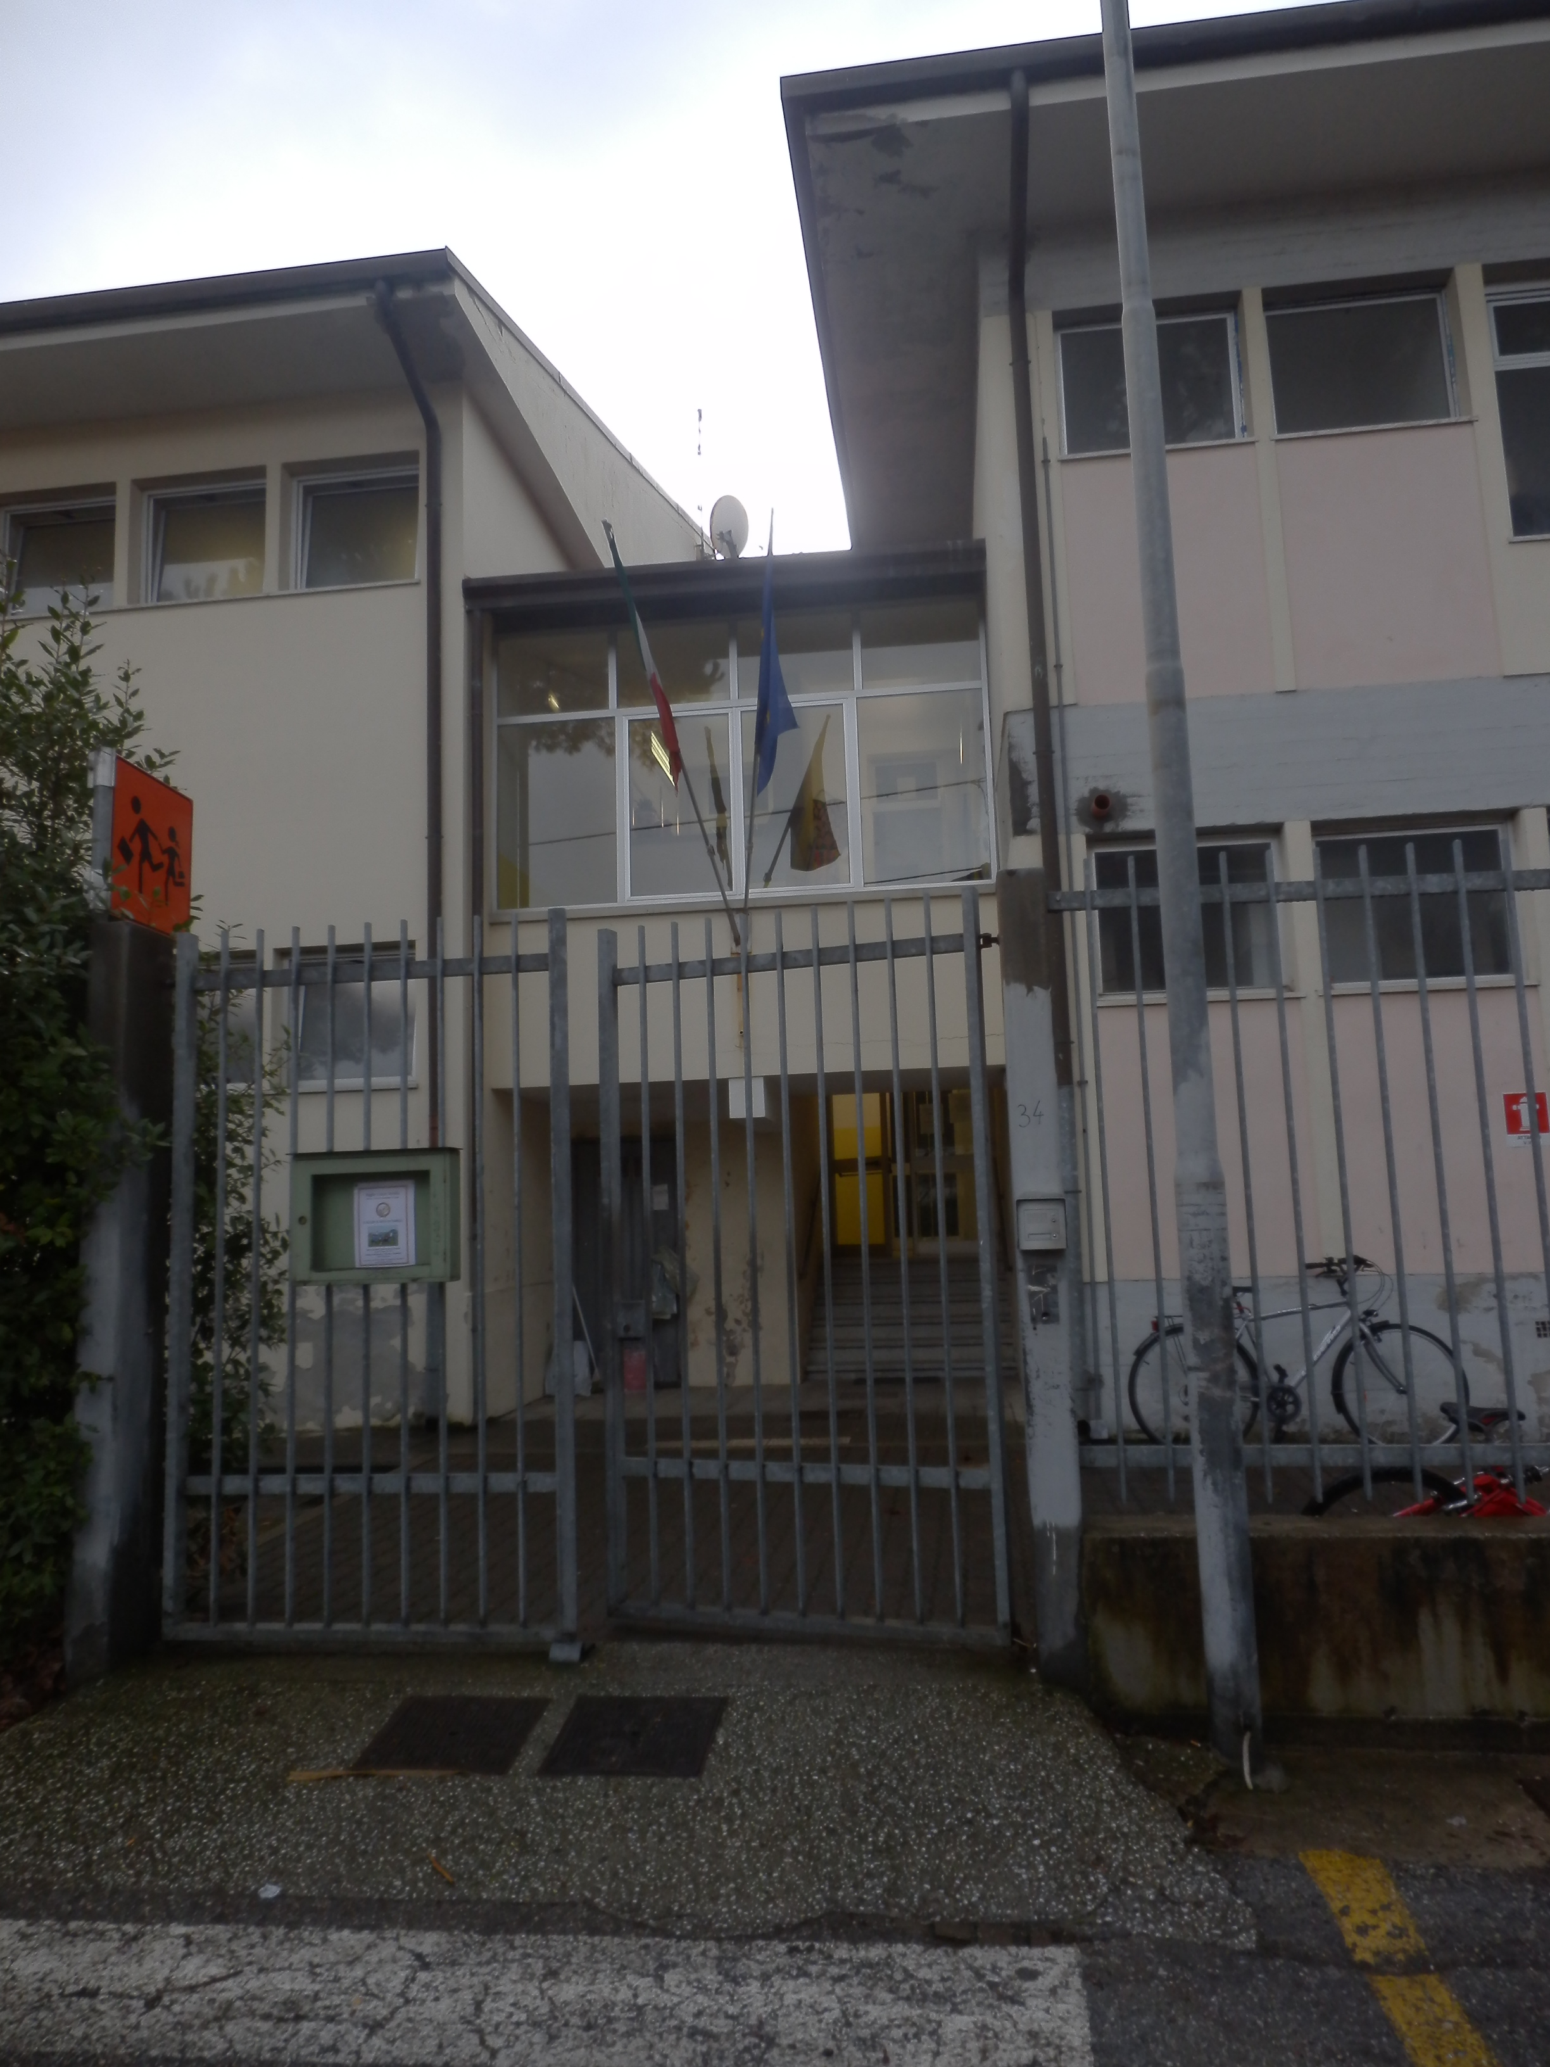
Welcome to Scuola Media Santini in Italy

Slide 2
Our school
Our school is situated in Marina di Pietrasanta a small beautiful town on the Tyrrennian Sea.
Our town is in Tuscany near Pisa. The famous town of “The leaning Tower”.
Our school ‘s name is “ Media Santini”.It is a little school with six classrooms and some special rooms for laboratories.

Slide 3
Our Gym!
This is our gym where we go for two periods a week to play volleyball, to run, to jump, to play basket, to try Rugby.
After school we can join a musical course, have dance lessons, do artistic gymnastic and have a lot of fun.

Slide 4
The art laboratory
This is our art laboratory room.
Here we go for two periods a week and we draw , paint,make mosaic and study History of Art.
.It is a beautiful classroom because on the walls there are our “works of art” : our drawings.

Slide 5
The Music Laboratory
This is our Music Laboratory room.Here we go for two periods a week.We play piano or the recorder and we listen to music and study the History of Music.

Slide 6
Here are the staff!

Slide 7
Manuela Bianchi is our History, Italian, Grammar and Geography teacher. She lives in Pietrasanta. Her passions are dancing and reading poetry.

Slide 8
Enrico Bassano Is our Maths teacher. He is very strict but nice. His passion is Sup, that is “Stand up paddle”. It is a particular form of surf.

Slide 9
This is Alfredo Montano. He is our caretaker. His passions are horses and Rock music. His favourite football team is Juventus

Slide 10
Cinzia Ingellis is our English teacher. Her passion is watching BBC TV. Her favourite singer is Freddy Mercury. Her favourite football team is Inter.

